Slide 1
Elliptic Curve Cryptography

Slide 2
What’s wrong with RSA?
RSA is based upon the ‘belief’ that factoring is ‘difficult’ – never been proven
Prime numbers are getting too large
Amount of research currently devoted to factoring algorithms
Quantum computing will make RSA obsolete overnight

Slide 3
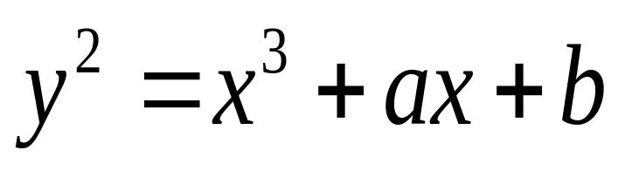
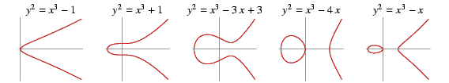
General form of a EC
An elliptic curve is a plane curve defined by an equation of the form
Examples

Slide 4
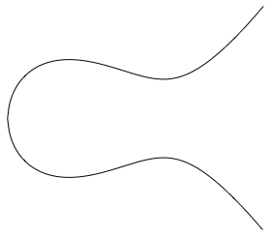
Elliptic Curve Picture
y
Consider elliptic curve
  E: y² = x³ - x + 1
If P₁ and P₂ are on E, we can define
P₃ = P₁ + P₂
as shown in picture
P₂
P₁
x
P₃

Slide 5
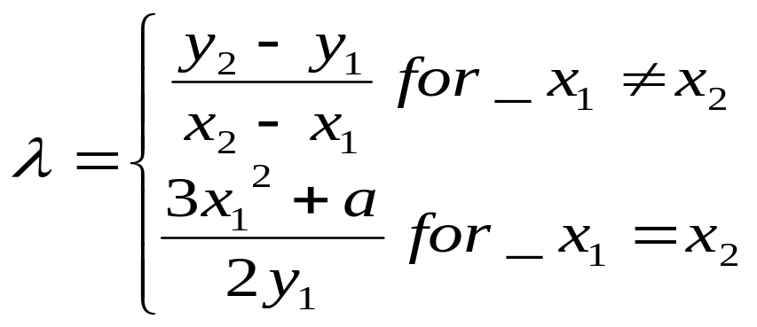
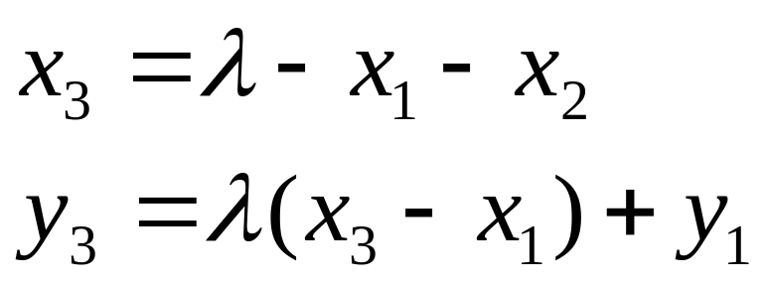
Sum of two points
Define for two points P (x₁,y₁) and Q (x₂,y₂) in the Elliptic curve
Then P+Q is given by R(x₃,y₃) :
2

Slide 6
Information on Elliptic Curves and Groups
Elliptic curves are algebraic/geometric entities that have been studied extensively for the past 150 years.
Has emerged a rich and deep theory.
Cryptosystems often require the use of algebraic groups.
A group is a set of elements with custom-defined arithmetic operations on those elements.
Elliptic curves may be used to form elliptic curve groups.
For elliptic curve groups, these specific operations are defined geometrically.
Introducing more stringent properties to the elements of a group,
  Eg. limiting the number of points on such a curve, creates an underlying field for an elliptic curve group.

Slide 7
Group
A group is an algebric system consisting of a set G together with a binary operation * defined on G satisfying the following axioms :
1. Closure : for all x,y in G we have x * y ∈ G
2. Associativity : for all x,y and z in G we have
(x * y) * z = x * (y * z)
3. Identity : there exists an e in G such that x * e = e * x = x
for all x
Inverse : for all x in G there exists y in G such that
x * y = y * x = e
In addition if for x, y in G we have x * y = y * x then we say that group G is abelian.

Slide 8
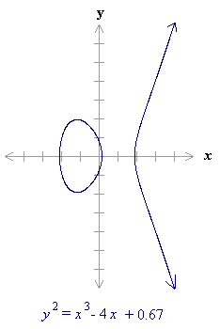
An elliptic curve over real numbers
It is defined as the set of points (x,y) which satisfy an elliptic curve equation of the form:
y² = x³ + ax + b,
where x, y, a and b are real numbers.
Each choice of the numbers a and b yields a different elliptic curve.
For example, a = -4 and b = 0.67 gives the elliptic curve with equation
y² = x³ - 4x + 0.67;
the graph of this curve is shown.

Slide 9
An EC over real numbers – cont’d
If x³ + ax + b contains no repeated factors, or
Equivalently if 4a³ + 27b² is not 0,
then the elliptic curve y² = x³ + ax + b can be used to form a group.
An elliptic curve group over real numbers consists of the points on the corresponding elliptic curve, together with a special point O called the point at infinity.

Slide 10
Elliptic curve groups are additive groups
Elliptic curve groups are additive groups;
That is, their basic function is addition.
The addition of two points in an elliptic curve is defined geometrically.
The negative of a point P = (xP,yP) is its reflection in the x-axis: the point -P is (xP,-yP).
Notice that for each point P on an elliptic curve, the point -P is also on the curve

Slide 11
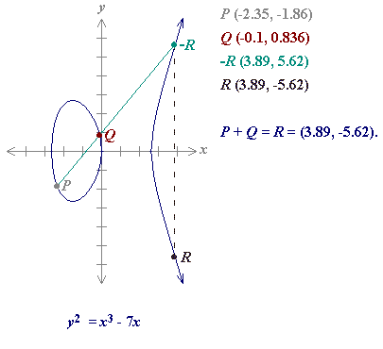
Adding distinct points P and Q
Suppose that P and Q are two distinct points on an elliptic curve, and the P is not -Q.
To add the points P and Q, a line is drawn through the two points.
This line will intersect the elliptic curve in exactly one more point, call -R.
The point -R is reflected in the x-axis to the point R.
The law for addition in an elliptic curve group is P + Q = R. For example

Slide 12
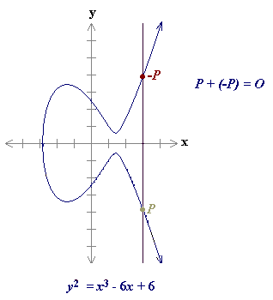
ECC
The line through P and -P is a vertical line which does not intersect the elliptic curve at a third point;
Thus the points P and -P cannot be added as previously.
It is for this reason that the elliptic curve group includes the point at infinity O.
By definition, P + (-P) = O. As a result of this equation, P + O = P in the elliptic curve group .
O is called the additive identity of the elliptic curve group; all elliptic curves have an additive identity

Slide 13
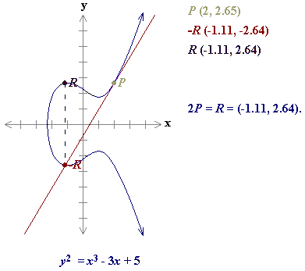
ECC
To add a point P to itself, a tangent line to the curve is drawn at the point P.
If yP is not 0, then the tangent line intersects the elliptic curve at exactly one other point, -R.
-R is reflected in the x-axis to R.
This operation is called doubling the point P;
the law for doubling a point on an elliptic curve group is defined by:
P + P = 2P = R.

Slide 14
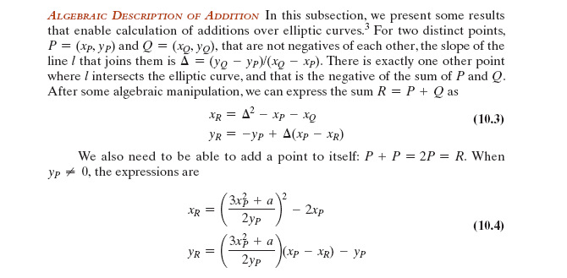


Slide 15
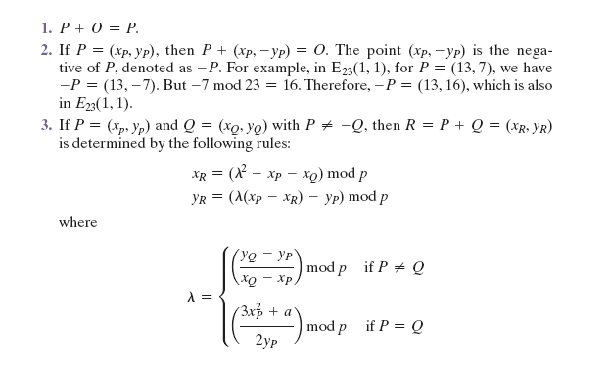
Elliptic Curves over Zp

Slide 16
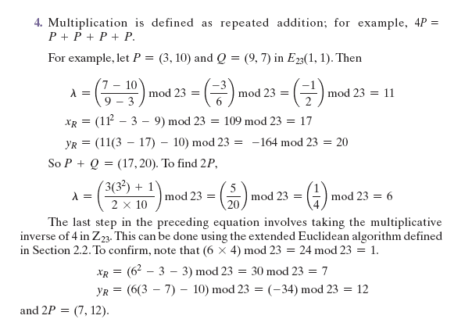

Slide 17

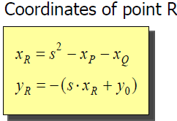
P + P = 2P = R.

Slide 18
Try the following experiments:
Change the variables a and b to see the resulting shape and the elliptic curve.
Select a point P on the curve, and then select a point Q on the curve. Add them together.
Select a point P on the curve and then double it.
Try selecting a = -3 and b = 2

Slide 19
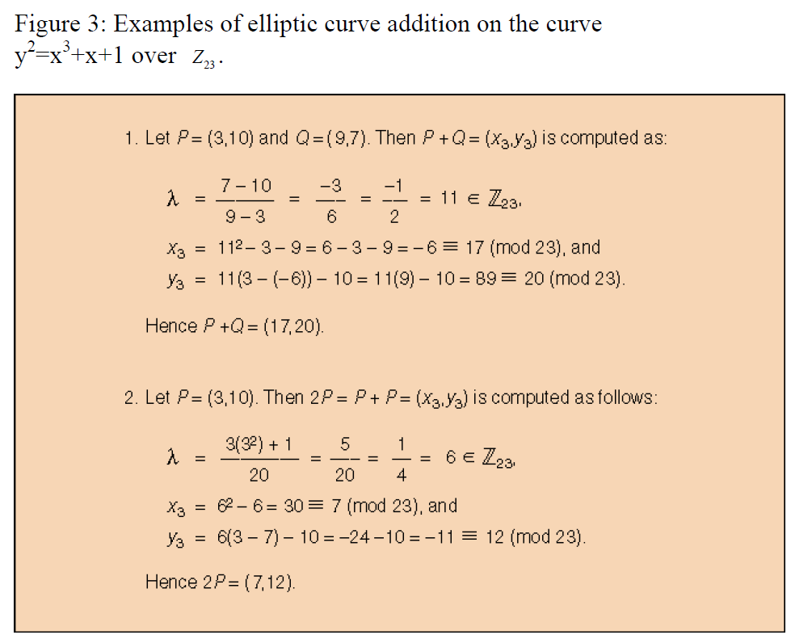
Solve

Slide 21
Quiz 1
Does the elliptic curve equation y² = x³ - 7x - 6 over real numbers define a group?
What is the additive identity of regular integers?
Is (4,7) a point on the elliptic curve y² = x³ - 5x + 5 over real numbers?

Slide 22
Quiz 1
4. In the elliptic curve group defined by y² = x³ - 17x + 16 over real numbers, what is P + Q if P = (0,-4) and Q = (1,0)?
5. In the elliptic curve group defined by y² = x³ - 17x + 16 over real numbers, what is 2P if P = (4, 3.464)?

Slide 23
Discrete Logarithm Problem
The security of ECC depends on the difficulty of Elliptic Curve Discrete Logarithm Problem.
Let P and Q be two points on an elliptic curve such that kP = Q, where k is a scalar.
Given P and Q, it is computationally infeasible to obtain k, if k is sufficiently large.
k is the discrete logarithm of Q to the base P.
Hence the main operation involved in ECC is point multiplication. i.e. multiplication of a scalar k with any point P on the curve to obtain another point Q on the curve.

Slide 24
What Is ECC ?
Elliptic curve cryptography [ECC] is a public-key cryptosystem just like RSA.
Every user has a public and a private key.
  Public key is used for encryption/signature verification.
  Private key is used for decryption/signature generation.

Slide 25
Extension
Elliptic curves are used as an extension to other current cryptosystems.
  Elliptic Curve Diffie-Hellman Key Exchange
  Elliptic Curve Digital Signature Algorithm

Slide 26
Using Elliptic Curves In Cryptography
The central part of any cryptosystem involving elliptic curves is the elliptic group.
All public-key cryptosystems have some underlying mathematical operation.
  RSA has exponentiation (raising the message or ciphertext to the public or private values)
  ECC has point multiplication (repeated addition of two points).

Slide 27
Suppose Alice wants to send to Bob an encrypted message.
  Both agree on a base point, B.
  Alice and Bob create public/private keys.
    Alice
      Private Key = a
      Public Key = P_{A} = a * B
    Bob
      Private Key = b
      Public Key = P_{B} = b * B
  Alice takes plaintext message, M, and encodes it onto a point, P_{M}, from the elliptic group

Slide 28
  Alice chooses another random integer, k from the interval [1, p-1]
  The ciphertext is a pair of points
    P_{C} = [ (kB), (P_{M} + kP_{B}) ]
  To decrypt, Bob computes the product of the first point from P_{C} and his private key, b
    b * (kB)
  Bob then takes this product and subtracts it from the second point from P_{C}
    (P_{M} + kP_{B}) – [b(kB)] = P_{M} + k(bB) – b(kB) = P_{M}
    (BECAUSE P_{B} = b * B)
  Bob then decodes P_{M} to get the message, M.

Slide 29

Discrete Logarithms in Finite Fields
F={1,2,3,…,p-1}
Pick secret, random Y from F
Pick secret, random X from F
g^{x} mod p
g^{y} mod p
Alice
Bob
Compute k=(g^{y})^{x}=g^{xy} mod p
Compute k=(g^{x})^{y}=g^{xy} mod p
Eve has to compute g^{xy} from g^{x} and g^{y} without knowing x and y…
She faces the Discrete Logarithm Problem in finite fields

Slide 30
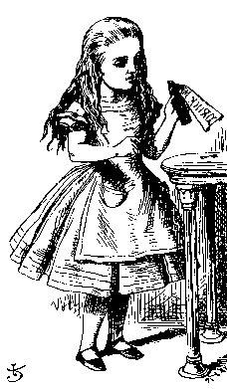
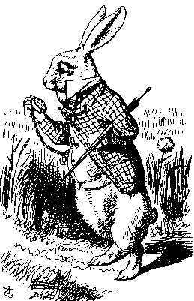
ECC Diffie-Hellman
Public: Elliptic curve and point B=(x,y) on curve
Secret: Alice’s a and Bob’s b
a(x,y)
b(x,y)
Alice, A
Bob, B
Alice computes a(b)
Bob computes b(a)
These are the same since ab = ba

Slide 31
Example – Elliptic Curve
Diffie-Hellman Exchange
Alice and Bob want to agree on a shared key.
  Alice and Bob compute their public and private keys.
    Alice
        Private Key = a
        Public Key = P_{A} = a * B
    Bob
        Private Key = b
        Public Key = P_{B} = b * B
  Alice and Bob send each other their public keys.
  Both take the product of their private key and the other user’s public key.
    Alice → K_{AB} = a(bB)
    Bob → K_{AB} = b(aB)
    Shared Secret Key = K_{AB} = abB

Slide 32
Why use ECC?
How do we analyze Cryptosystems?
  How difficult is the underlying problem that it is based upon
    RSA – Integer Factorization
    DH – Discrete Logarithms
    ECC - Elliptic Curve Discrete Logarithm problem
  How do we measure difficulty?
    We examine the algorithms used to solve these problems

Slide 33
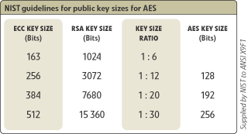
Security of ECC
To protect a 128 bit AES key it would take a:
  RSA Key Size: 3072 bits
  ECC Key Size: 256 bits
How do we strengthen RSA?
  Increase the key length
Impractical?

Slide 34
Applications of ECC
Many devices are small and have limited storage and computational power
Where can we apply ECC?
  Wireless communication devices
  Smart cards
  Web servers that need to handle many encryption sessions
  Any application where security is needed but lacks the power, storage and computational power that is necessary for our current cryptosystems

Slide 35
Benefits of ECC
Same benefits of the other cryptosystems: confidentiality, integrity, authentication and non-repudiation but…
Shorter key lengths
  Encryption, Decryption and Signature Verification speed up
  Storage and bandwidth savings

Slide 36
1. Does the elliptic curve equation y²= x³- 7x - 6 over real numbers define a group?
Yes, since
4a³+ 27b²= 4(-7)³+ 27(-6)²= -400
The equation y²= x³- 7x - 6 does define an elliptic curve group because 4a³+ 27b²is not 0.

Slide 37
2. What is the additive identity of regular integers?
The additive identity of regular integers is 0,
since x + 0 = x for all integers.

Slide 38
3. Is (4,7) a point on the elliptic curve y²= x³- 5x + 5 over real numbers?
Yes, since the equation holds true for x = 4 and
y = 7:
(7)²= (4)³- 5(4) + 5
49 = 64 - 20 + 5
49 = 49

Slide 39
4. In the elliptic curve group defined by y²= x³- 17x + 16 over real numbers, what is P + Q if P = (0,-4) and Q = (1,0)?
From the Addition formulae:
s = (y_{P}- y_{Q}) / (x_{P}- x_{Q}) = (-4 - 0) / (0 - 1) = 4
x_{R}= s²- x_{P}- x_{Q}= 16 - 0 - 1 = 15
and
y_{R}= -y_{P}+ s(x_{P}- x_{R}) = 4 + 4(0 - 15) = -56
Thus P + Q = (15, -56)

Slide 40
5. In the elliptic curve group defined by y²= x³- 17x + 16 over real numbers, what is 2P if P = (4, 3.464)?
From the Doubling formulae:
s = (3x_{P}²+ a) / (2y_{P})
    = (3*(4)²+ (-17)) / 2*(3.464) = 31 / 6.928 = 4.475
    x_{R} = s²- 2x_{P}
    = (4.475)²- 2(4)
    = 20.022 – 8 = 12.022 and
    y_{R}= -y_{P}+ s(x_{P}- x_{R})
    = -3.464 + 4.475(4 - 12.022)
    = - 3.464 - 35.898 = -39.362
    Thus 2P = (12.022, -39.362)

Slide 41
In the elliptic curve group defined by y2=x3+9x+17over F23,
what is the discrete logarithm k of Q=(4,5) to the base P=(16,5)?

Slide 42
One (naïve) way to find k is to compute multiples of P until Q is found. The first few multiples of Pare:
P=(16,5) 2P=(20,20) 3P=(14,14),
4P=(19,20) 5P=(13,10) 6P=(7,3),
7P=(8,7) 8P=(12,17) 9P=(4,5)
Since 9P=(4,5)=Q , the discrete logarithm of Q to the base P is k=9

Slide 44
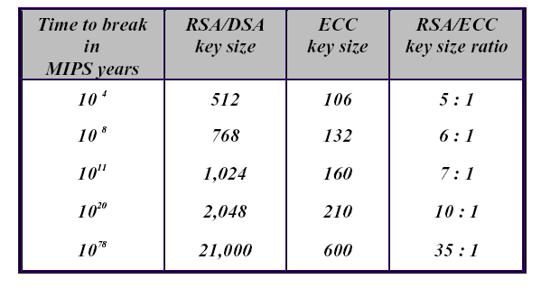
Public-Key Cryptosystem Comparison
(RSA vs ECC)
A MIPS year represents a computing time of one year on a machine capable of performing one million instructions per second.

Slide 45
3 Cases for Solutions
Suppose P, Q ∈ E, where P = (x₁,y₁) and Q = (x₂,y₂), we must consider three cases:
1.) x₁ ≠ x₂
2.) x₁ = x₂ and y₁ = - y₂
3.) x₁ = x₂ and y₁ = y₂
These cases must be considered when defining “addition” for our solution set

Slide 46
Defining Addition on E: Case 1
For the case x₁ ≠ x₂, addition is defined as follows:
(x₁,y₁) + (x₂,y₂) = (x₃,y₃) ∈ E where
x₃ = λ² - x₁ - x₂
y₃ = λ(x₁ – x₃) - y₁, and
λ = (y₂ – y₁) / (x₂ – x₁)

Slide 47
Defining Addition on E : Case 2
For the case x₁ = x₂ and y₁ = - y₂ , addition is defined as follows:
(x₁,y₁) + (x₂,y₂) = (x₃,y₃) ∈ E where
(x,y) + (x,-y) = O, the point at infinity

Slide 48
Defining Addition on E : Case 3
For the case x₁ = x₂ and y₁ = y₂, addition is defined as follows:
(x₁,y₁) + (x₂,y₂) = (x₃,y₃) ∈ E where
x₃ = λ² - x₁ - x₂
y₃ = λ(x₁ – x₃) - y₁, and
λ = (3x₁² + a) / 2y₁

